Slide 1
Luxury Rental Inc.
Phuc Dang | Bogun kim
CSC 4370

Slide 2

What is Luxury Rental Inc.?
An online virtual agent that simulate the automation of a rental car service.

Slide 3
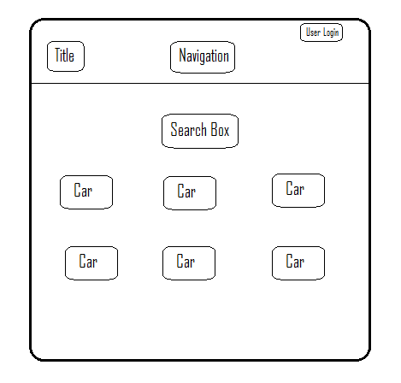
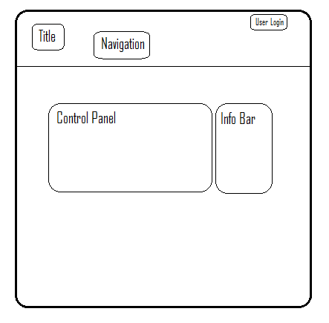
Design

Slide 4
Challenges
Communicating with MySQL through PHP
Pulling data from database
Implementing admin’s features
Auto-detecting Credit Card type

Slide 5
Code Snippet
Creating table:
CREATE TABLE `cars` (
`car_id` int(11) NOT NULL AUTO_INCREMENT,
`car_name` varchar(255) NOT NULL,
`car_type` varchar(255) NOT NULL,
`image` text NOT NULL,
`status` varchar(255) NOT NULL,
PRIMARY KEY (`car_id`)
)
Adding data to table:
INSERT INTO `cars` VALUES (19,'i8','2016 BMW','2016-bmw-i8.jpg',600,'Available'),
(20,'GS350','2014 Lexus','lexus-gs-04.jpg',180,'Available'),
(21,'s63 amg','2016 Mercedes','s63.jpg',300,'Available'),
(22,'Ghibli','2015 Maserati','Ghibli.JPG',239,'Available'),
(23,'Panigale S','2015 Ducati','pani.jpg',199,'Available'),
(24,'Dragster 800','2014 MV Agusta','14dragster.jpg',159,'Available');

Slide 6
Code Snippet
Pulling data from database:
<section class="listings">
<div class="wrapper">
<ul class="properties_list">
<?php
include 'includes/config.php';
$sel = "SELECT * FROM cars WHERE status = 'Available'";
$rs = $conn->query($sel);
while($rws = $rs->fetch_assoc()){
?>
<li>
<a href="book_car.php?id=<?php echo $rws['car_id'] ?>">
<img class="thumb" style="border-radius:50px" src="cars/<?php echo $rws['image'];?>" width="360" height="240">
</a>
<span class="price"><?php echo '$'.$rws['hire_cost'].'/day' ;?></span>
<div class="property_details">
<h2> Year/Make: <span class="property_size"><?php echo $rws['car_type'];?></span></h2>
<h2>Model: <span class="property_size"><?php echo $rws['car_name'];?></span></h2>
</div>
</li>

Slide 7
Code Snippet
Credit card:
(function( $ ) { $.fn.creditCardTypeDetector = function( options ) {
var settings = $.extend( {
'credit_card_logos_id': '.card_logos'
}, options),
// the object that contains the logos
logos_obj = $(settings.credit_card_logos_id),
// the regular expressions check for possible matches as you type, hence the OR operators based on the number of chars
// Visa
visa_regex = new RegExp('^4[0-9]{0,15}$'),
// MasterCard
mastercard_regex = new RegExp('^5$|^5[1-5][0-9]{0,14}$'),
// American Express
amex_regex = new RegExp('^3$|^3[47][0-9]{0,13}$'),
//Discover
discover_regex = new RegExp('^6$|^6[05]$|^601[1]?$|^65[0-9][0-9]?$|^6(?:011|5[0-9]{2})[0-9]{0,12}$'),

Slide 8
Live Demo

